Slide 1
Web Development For School Of Computer Science
under Dr. Gururaj Mukarambi

Slide 2
Introduction
We are carrying out the project on developing dynamic website for the School Of Computer Science in Central University of Karnataka, Kadaganchi, Kalaburagi.

Slide 3
Why this project?
purpose of providing the department related information to students.
Till now this website is static.
We are providing multiple modules for every single application like Alumni, department, Dean Massage, Flash news, . . . etc. Every module attaches with database and managed by its form or authorized user.

Slide 4
Goal of project
Make this site more friendly.
News easy to manage.
Design a beautiful Gallery with dynamic approach
Upload file as resources

Slide 5
Hardware Requirement
Processor - core i3 dual core
Memory of user PC- 512MB RAM
Disk space of user PC-2GB
Memory of server PC-4GB
Network Connection-5Mbps
Disk space of server-200GB
Printer- To print documents

Slide 6
Software Requirement
IDE : vscode studio, PHP strom
Database: mysql workbench
SERVER : XAMP
BACK-END : php, mysql, ajax, javascript
FRONT-END : html, css, JQuery

Slide 7
Used Language
HTML
CSS (BootStrap 4.0)
JavaScript
PHP
My SQL

Slide 8
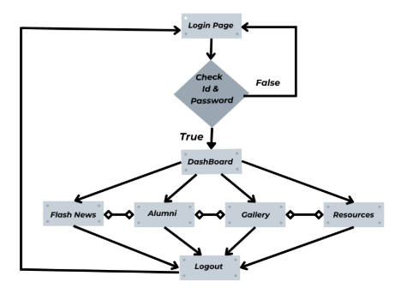
DFD

Slide 9
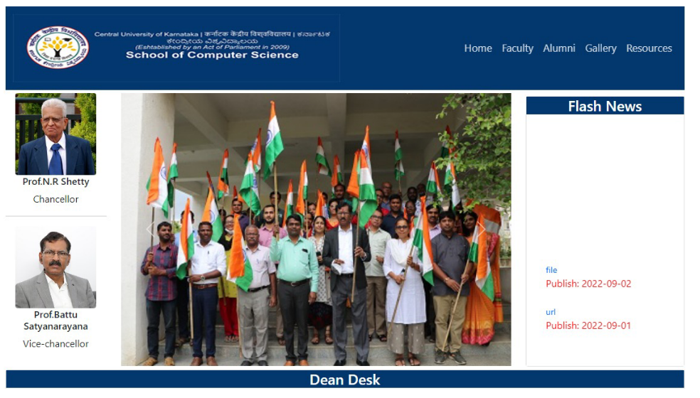
Some screenshot

Slide 10
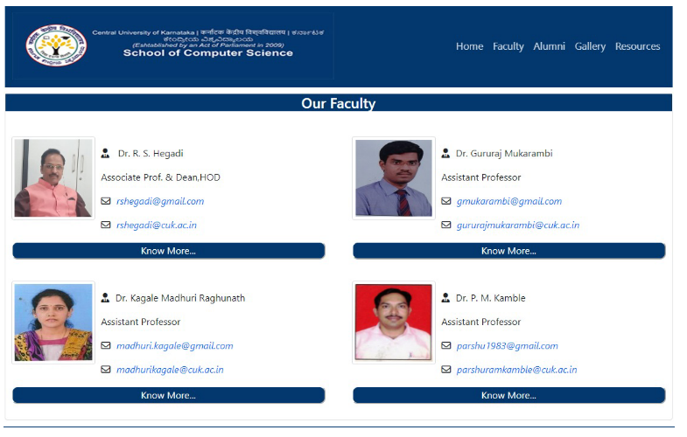

Slide 11
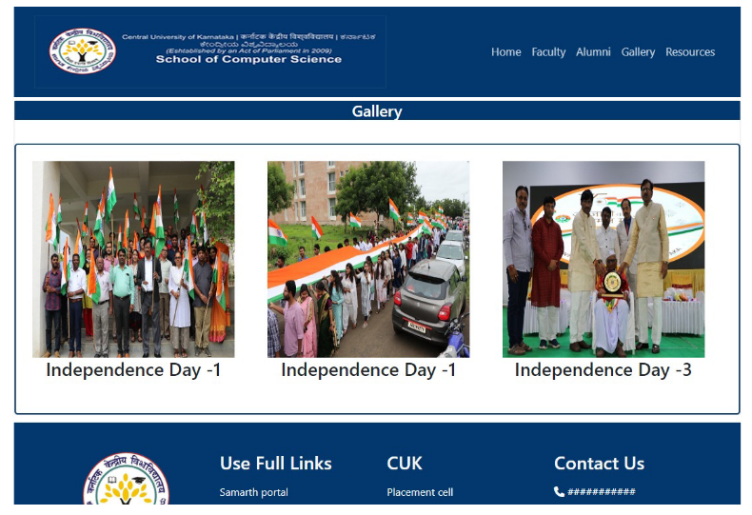

Slide 12
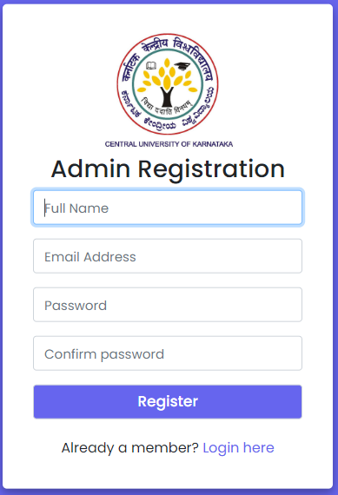
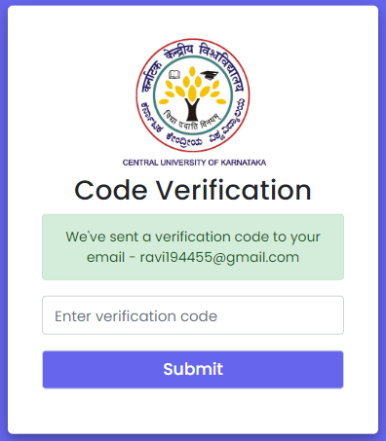
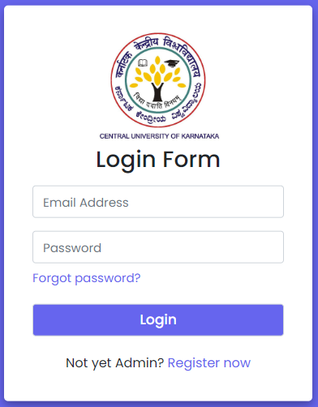
Login

Slide 13
References
https://www.w3schools.com/
https://getbootstrap.com/docs/4.0/getting-started/introduction/
https://www.mysqltutorial.org/
https://www.geeksforgeeks.org/

Slide 14
THANK YOU
RAVI KMAR
Roll no: 2021MCA14
Aman Bhardwaj
Roll no: 2021MCA22

